Slide 1
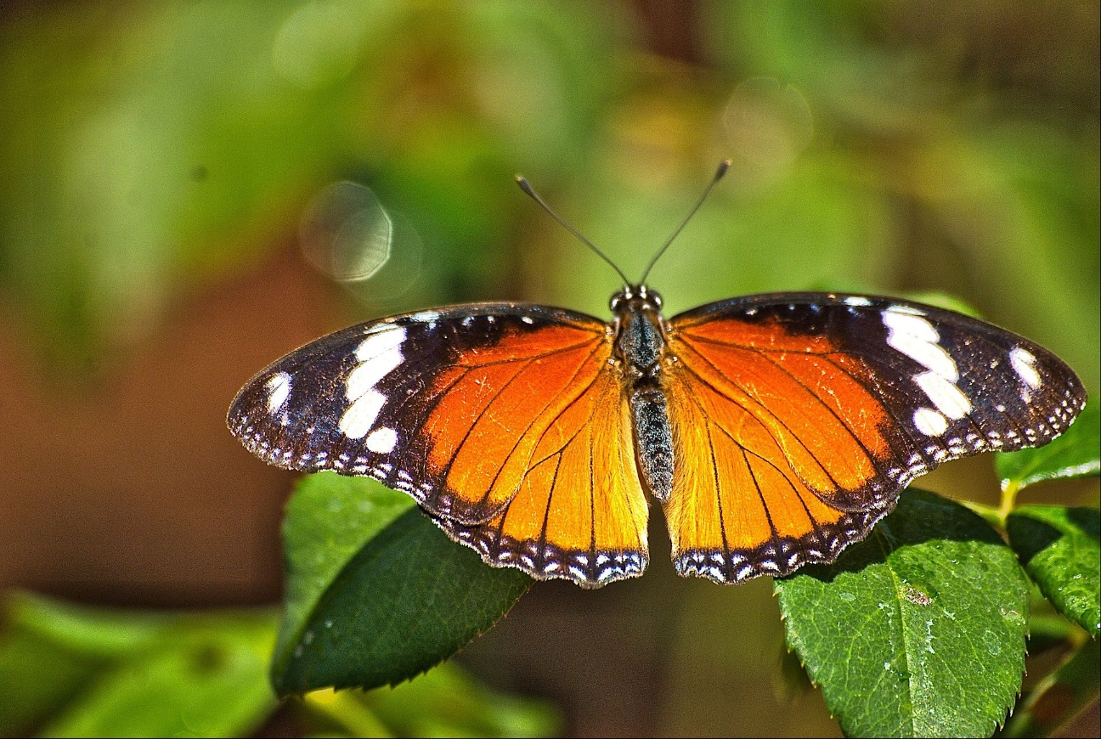
Example: Multiple Choice
Which of the following are NOT insects?
Ant
Tadpole
Ladybug
Spider
Bee

Slide 2
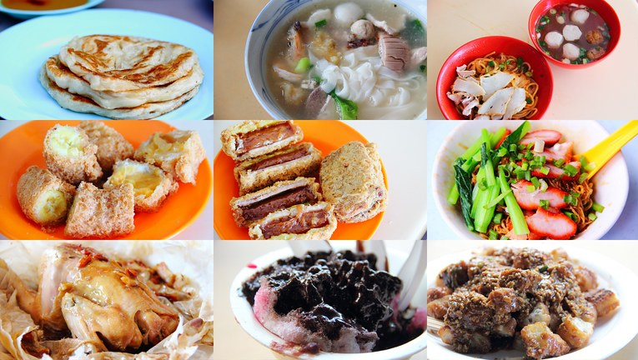
Example: Word Cloud
What are some of your favourite local food?

Slide 3
Example: Short Answer
How should we slow down global warming?

Slide 4
Example: Slide Drawing
Plot $y={−x}^{2}+3$

Slide 5
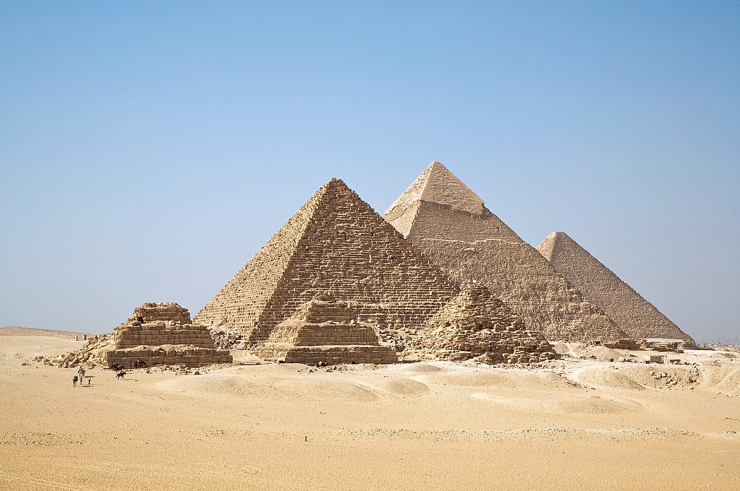
Example: Image Upload
Show a real-life example of Triangle

